Slide 1
Java Introduction
Java is a high-level programming language originally developed by Sun Microsystems and released in 1995.
Java runs on a variety of platforms, such as Windows, Mac OS, and the various versions of UNIX.
Java is an Object-Oriented Language that has the Object-Oriented feature.
It supports the following fundamental concepts (Polymorphism, Inheritance, Encapsulation, Abstraction, Classes, Objects, Instance, Method, Message Parsing).

Slide 2
Features of Java
Object Oriented: Everything is an Object in Java. Java can be easily extended since it is based on the Object model.
Platform Independent: Java is compiled, It is platform independent byte code. It is interpreted by the Virtual Machine (JVM) on whichever platform it is being run on.
Secure: It enables to develop virus-free, tamper-free systems. Authentication techniques are based on public-key encryption.

Slide 3
Contd…
Architecture-neutral: Java compiler generates an architecture-neutral object file format, which makes the compiled code executable on many processors.
Portable: Compiler in Java is written in ANSI C with a clean portability boundary
Multithreaded −It is possible to write programs that can perform many tasks simultaneously.

Slide 4
Contd…
Interpreted − Java byte code is translated on the fly to native machine instructions and is not stored anywhere. It is light-weight process.
High Performance − With the use of Just-In-Time compilers, Java enables high performance.
Distributed − Java is designed for the distributed environment of the internet.
Dynamic − Java is considered to be more dynamic than C or C++ since it is designed to adapt to an evolving environment.

Slide 5
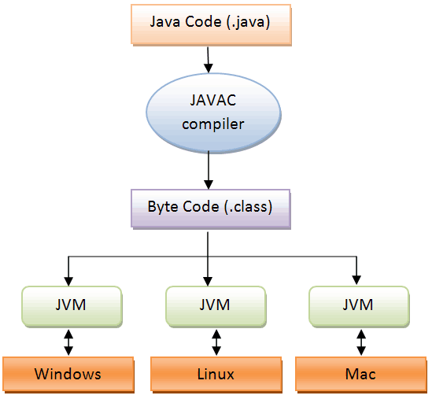
Java architecture

Slide 6
Java Virtual Machine (JVM)
JVM is an abstract computing machine, or virtual machine that enables a computer to run a java program.
It is a platform-independent execution environment that converts Java bytecode into machine language and executes it.
It compiles the source code into a machine independent code, which is also called Java Byte Code.
It is a specification that provides runtime environment in which java bytecode can be executed.

Slide 7
Java Runtime Environment (JRE)
The Java Runtime Environment (JRE), also known as Java Runtime, is part of the Java Development Kit (JDK), a set of programming tools for developing Java applications.
The Java Runtime Environment provides the minimum requirements for executing a Java application.
it consists of the Java Virtual Machine (JVM), core classes, and supporting files.
It is a software package that contains what is required to run a Java program.
It includes a Java Virtual Machine implementation together with an implementation of the Java Class Library.

Slide 8
Java Development Kit (JDK)
It is a software development environment used for developing Java applications and applets.
It includes the Java Runtime Environment (JRE), an interpreter/loader (java), a compiler (javac), an archiver (jar), a documentation generator (javadoc) and other tools needed in Java development.
It is a superset of a JRE and contains tools for Java programmers, e.g. a javac compiler. The Java Development Kit is provided free of charge either by Oracle Corporation directly, or by the OpenJDK open source project, which is governed by Oracle.

Slide 9
Java Basic
Case Sensitivity − Java is case sensitive, which means identifier Hello and hello would have different meaning in Java.
Program File Name − Name of the program file should exactly match the class name.
Example: Assume 'MyFirstJavaProgram' is the class name. Then the file should be saved as 'MyFirstJavaProgram.java’
To compile: javac MyFirstJavaProgram.java
To execute: java MyFirstJavaProgram
public static void main(String args[]) − Java program processing starts from the main() method which is a mandatory part of every Java program.

Slide 10
Contd…
Object − Objects have states and behaviors. Example: A dog has states - color, name, breed as well as behavior such as wagging their tail, barking, eating. An object is an instance of a class. The new keyword is used to create new objects.
Class − A class can be defined as a template/blueprint that describes the behavior/state that the object of its type supports. Objects are created from class.
Methods − A method is basically a behavior. A class can contain many methods. It is in methods where the logics are written, data is manipulated and all the actions are executed.
Instance Variables − Each object has its unique set of instance variables. An object's state is created by the values assigned to these instance variables.

Slide 11
Java Identifiers
All Java components require names. Names used for classes, variables, and methods are called identifiers.
All identifiers should begin with a letter (A to Z or a to z), currency character ($) or an underscore (_).
After the first character, identifiers can have any combination of characters.
A key word cannot be used as an identifier.
Most importantly, identifiers are case sensitive.
Examples of legal identifiers: age, $salary, _value, __1_value.
Examples of illegal identifiers: 123abc, -salary.

Slide 12
Variables
The variable is the basic unit of storage in a java program. A variable is defined by the combination of an identifier, a type, and an optional initializer. All variables have a scope, which defines their visibility and a lifetime.
Declaration: type identifier =value , identifier=value….
Int a, b , c; Int d=3, e, f=7;
Method
A Java method is a collection of statements that are grouped together to perform an operation.
<modifier> <returnType> nameOfMethod (Parameter List)
{ // method body
}

Slide 13
public class TestExample
{
public static void main(String[] args)
{
String fullName = GetFullName (“firstname”, “lastname”);
System.out.println("Full Name: " + fullName);
}
public static String GetFullName(String fname, String lname)
{
return fname + lname;
}
}

Slide 14
The Constructors
A constructor initializes an object when it is created. It has the same name as its class and is syntactically similar to a method. However, constructors have no explicit return type.
The this keyword
this is a keyword in Java which is used as a reference to the object of the current class, with in an instance method or a constructor. Using this you can refer the members of a class such as constructors, variables and methods.

Slide 15
import java.io.*;
public class Employee {
String name;
double salary;
public Employee(String name) {
this.name = name;
}
public void empSalary(double empSalary) {
salary = empSalary;
}
public void printEmployee() {
System.out.println("Name:"+ name );
System.out.println("Salary:" + salary);
}
}

Slide 16
import java.io.*;
public class EmployeeTest {
public static void main(String args[]) {
Employee empOne = new Employee("James Smith");
Employee empTwo = new Employee("Mary Anne");
empOne.empSalary(1000);
empOne.printEmployee();
empTwo.empSalary(500);
empTwo.printEmployee();
}
}

Slide 17
Arrays
An array is a group of similar-typed variables that are referred to by a common name.
Arrays of any type can be created and may have one or more dimensions.
A specific element in an array is accessed by its index.
Arrays offer a convenient means of grouping related information.
type var-name[];
int month_days[]; or month_days=new int[12];

Slide 18
Contd…
declaration of the array variable with the allocation of the array itself
type var-name[]=new type[size]; or int month_days[]=new int[12];
Two dimension array
int[][] multi = new int[5][10];

